Slide 1


Day 9: Uploading Reported Financial Data
Upload reported financial data

Slide 2
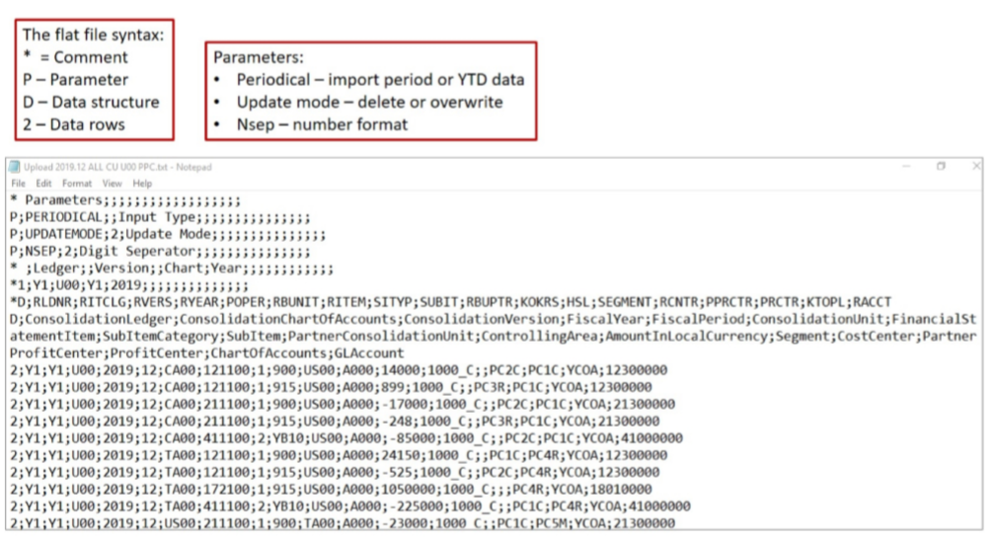
Upload Reported Financial Data

